Slide 1



Smart Expense Tracker
Java Swing + JDBC + MySQL Project
Your Name | Course | Date
In this presentation, we introduce the Smart Expense Tracker project — a Java-based desktop application designed to help users manage their personal finances effectively. It integrates a rich graphical user interface with robust backend technologies to deliver a seamless experience. We will walk through the project’s objective, architecture, key features, and implementation challenges.
Notes:
1

Slide 2
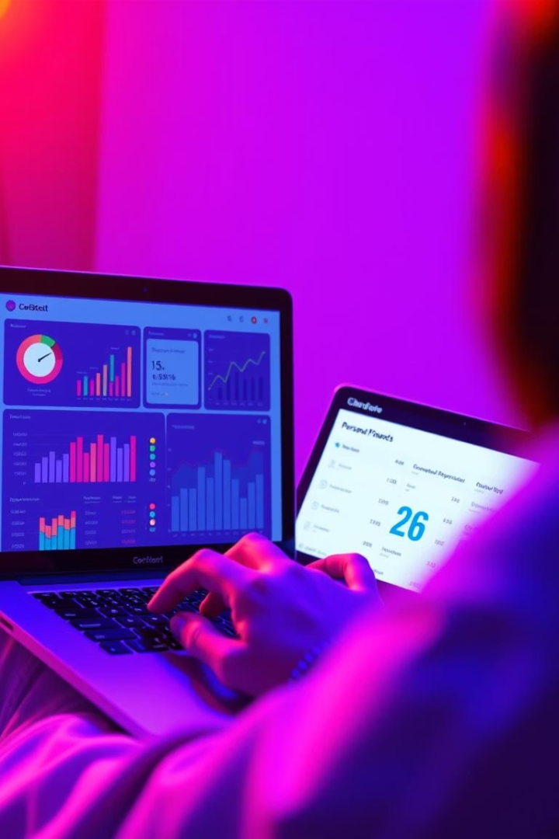
Introduction to Smart Expense Tracker
Manage Personal Finances
Track Spending by Category
This tool helps users keep track of their expenses effortlessly, categorizing expenditures by type and date for better financial oversight.
By pinpointing where money goes, users can identify spending patterns and make informed budgeting decisions.
Solve Manual Tracking Issues
Eliminates problems like lost receipts and unorganized records, providing a reliable digital alternative for expense management.
Notes:
2

Slide 3
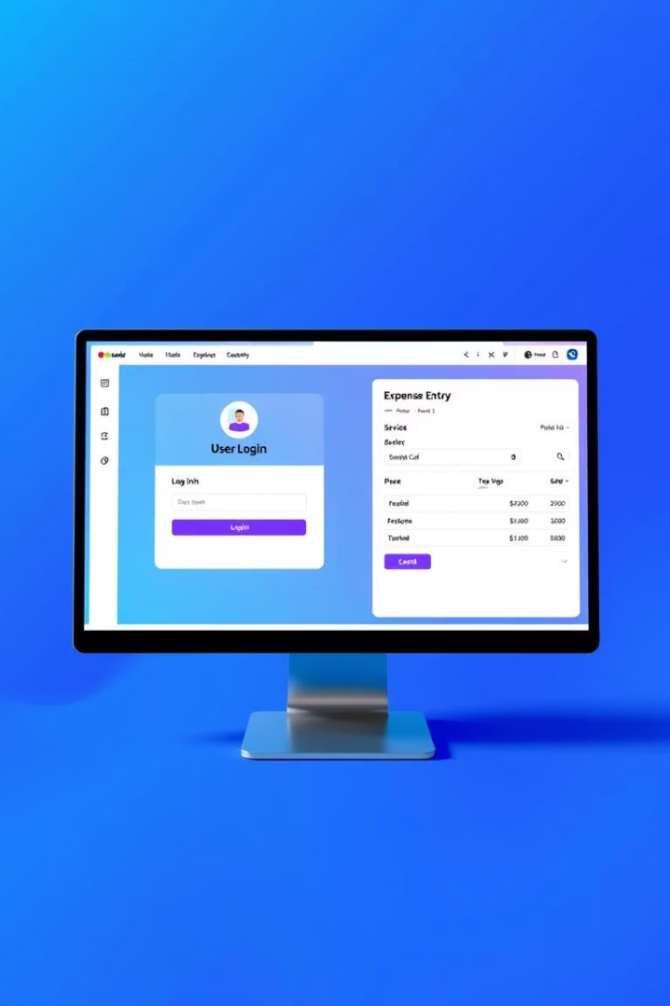
Project Objectives
User Registration & Login
Enable secure user authentication to maintain personal expense data privacy.
Add Expenses Efficiently
Allow users to record expenses with details like category, amount, and date quickly.
Secure Data Storage
Leverage MySQL to safely store user and expense data with integrity.
User-friendly GUI
Build an intuitive interface using Java Swing for a smooth user experience.
Notes:
3

Slide 4
Technologies Used
Java Swing
JDBC
MySQL
IDEs
Used for designing a responsive and efficient graphical user interface.
Handles database connectivity, executing queries and managing results between Java and MySQL.
A reliable relational database used to store user information and expenses securely.
Development leveraged VS Code and IntelliJ IDEA for coding, debugging, and project management.
Notes:
4

Slide 5
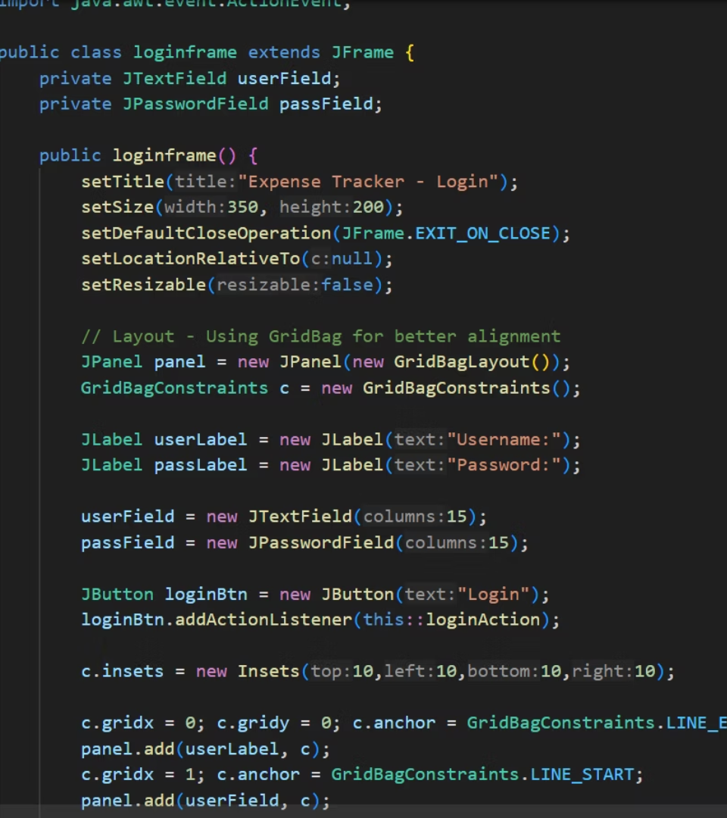
Project Structure Overview
File
Purpose
DBConnection.java
Handles establishing and managing the MySQL database connection.
User.java & Expense.java
Define data models representing users and their expenses.
UserDAO.java & ExpenseDAO.java
Responsible for performing CRUD operations on database tables.
LoginFrame, RegisterFrame, ExpenseFrame
GUI components for user login, registration, and expense management screens.
Main.java
Application entry point, initializes the GUI and application workflow.
Notes:
5

Slide 6
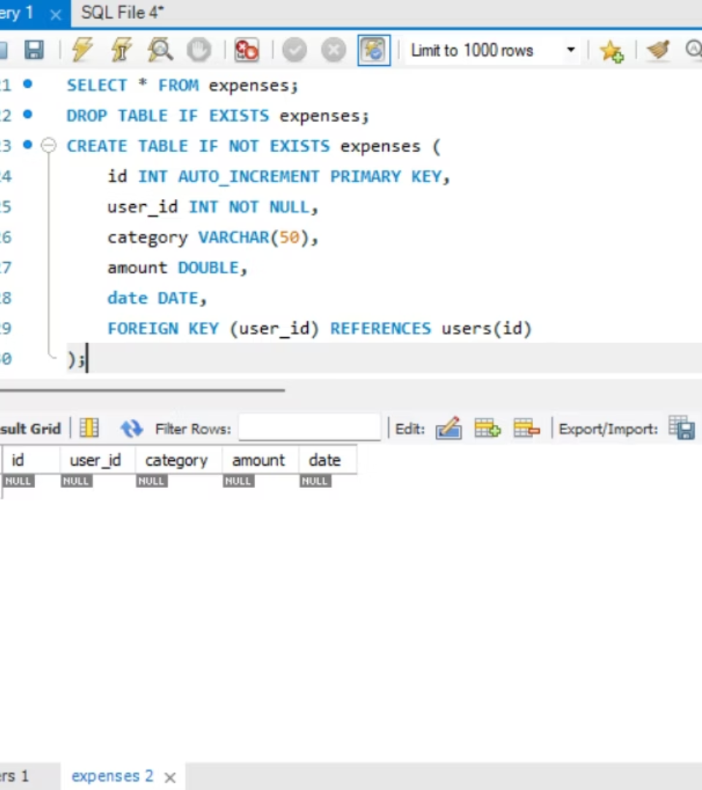
Database Design
Database: expense_tracker
Centralized relational database coordinating user and expense data efficiently.
Tables
users: Contains user id, username, and hashed password
expenses: Tracks each expense with user ID, category, amount, and date
Relationships
One-to-many association allowing each user to record multiple expenses, ensuring data integrity and ease of retrieval.
Notes:
6

Slide 7
Key Features
Secure Login & Registration
Categorized Expense Input
Implements authentication with input validation and encrypted password storage.
Allows users to efficiently enter and categorize expenses for detailed tracking.
Responsive UI
Error Handling & Validation
Designed with Java Swing for smooth navigation and clear visual hierarchy.
Includes validation checks and informative error messages for a robust experience.
Notes:
7

Slide 8
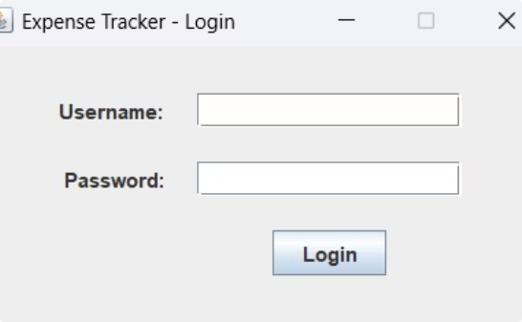
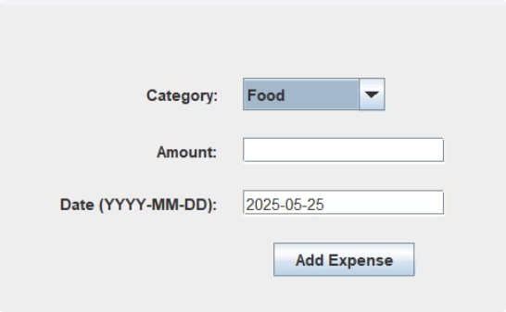
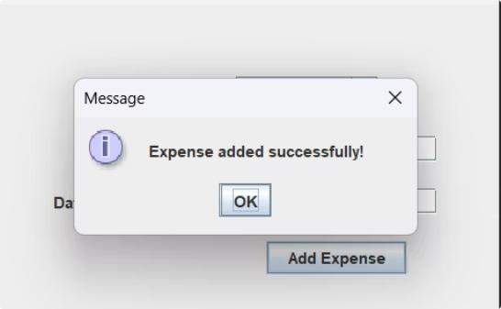
GUI Screenshots
Login Screen
Add Expense
Expense Add
Notes:
8

Slide 9
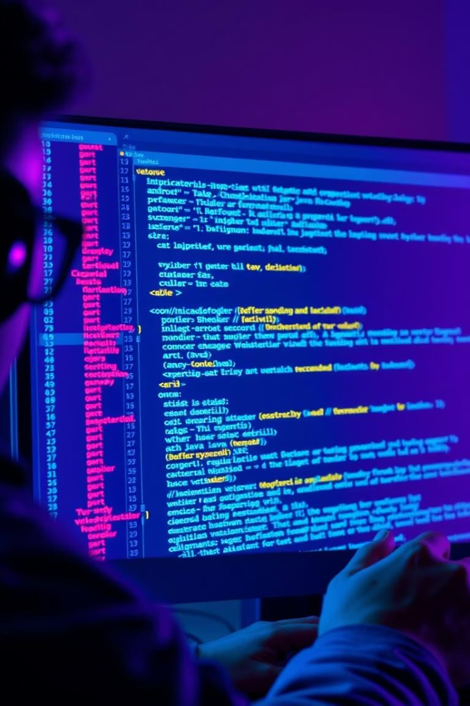
Challenges & Solutions
Database Connection Errors
Input Validation
Implemented thorough checks on all user fields to avoid invalid data and runtime issues.
Handled using try-catch blocks with user-friendly error messages to improve stability.
UI Alignment Issues
Resolved layout challenges by applying GridLayout and BorderLayout managers for consistency and aesthetics.
Notes:
9

Slide 10

Conclusion & Future Work
Completed Functional App
An effective Java Swing application integrating JDBC and MySQL for personal expense management.
Developed Key Skills
Enhanced expertise in Java GUI programming, database connectivity, and SQL data handling.
Future Enhancements
Plan to add advanced features like detailed reports, interactive charts, and multi-user roles for scalability.
Notes:
10

